Slide 1


MAK ENTERPRISES
IT STAFFING | RECRUITMENT| BUSINESS PROCESS OUTSOURCING|

Slide 2

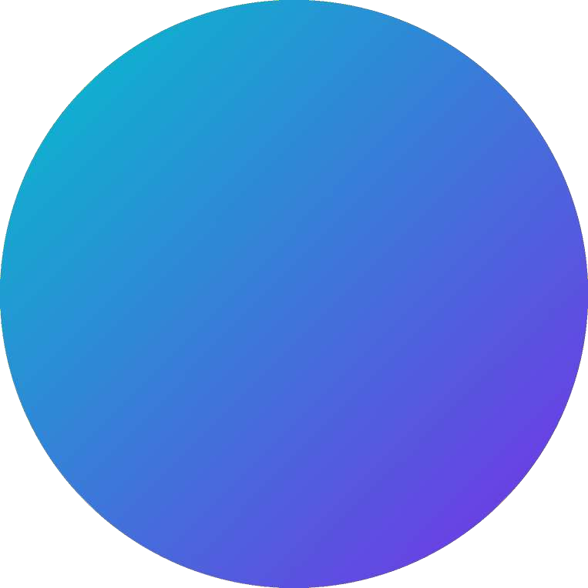


ABOUT OUR COMPANY
MAK Enterprises has been in business since the year 2013 offering recruitment and staffing solutions as the core business. With a current footprint spanning in Delhi NCR region, the company serves a galaxy of reputed clients in diverse sectors like IT, Manufacturing, Infrastructure, E-commerce, Telecom, etc. Over the years we have been successful in offering complete 360 degrees services in the area of Recruitment, Payroll Management, IT, and Non-IT Staffing to our clients.

Slide 3





OUR SERVICES
RECRUITMENT
BUSINESS PROCESS OUTSOURCING
TEAM STAFFING / PROJECT BASED ASSIGNMENTS
PERMANENT STAFFING WITH STATUTORY COMPLIANCES
IT SOLUTIONS- APPLICATION DEVELOPMENT AND MOBILE
APP

Slide 4
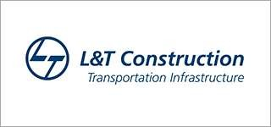
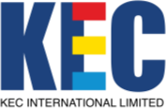









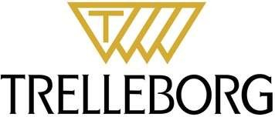

OUR KEY CLIENTELE

Slide 5



OUR EXPERTISES
Functional Project Manager
Site Engineer
Operation Executive
Research Analyst
Talent Acquisition Manager
Sales Executive Manager
Marketing Manager
Software Developer
Engineers

Slide 6


CONTACT US
info.makenterprises24@gmail.com
Call us now
+91 – 9999329855
+91 – 9711969152

Slide 7
THANK YOU

